Slide 1
Mid Progress Presentation
Chest diseases classification using DenseNet121
Computer vision and Machine learning
Omikumar Makadia, Pratham Mehta, Purvansh Barodia
BTech. CSE, School of Engineering and Applied Sciences
Mentor
Professor Mehul Raval, School of Engineering and Applied Sciences

Slide 2
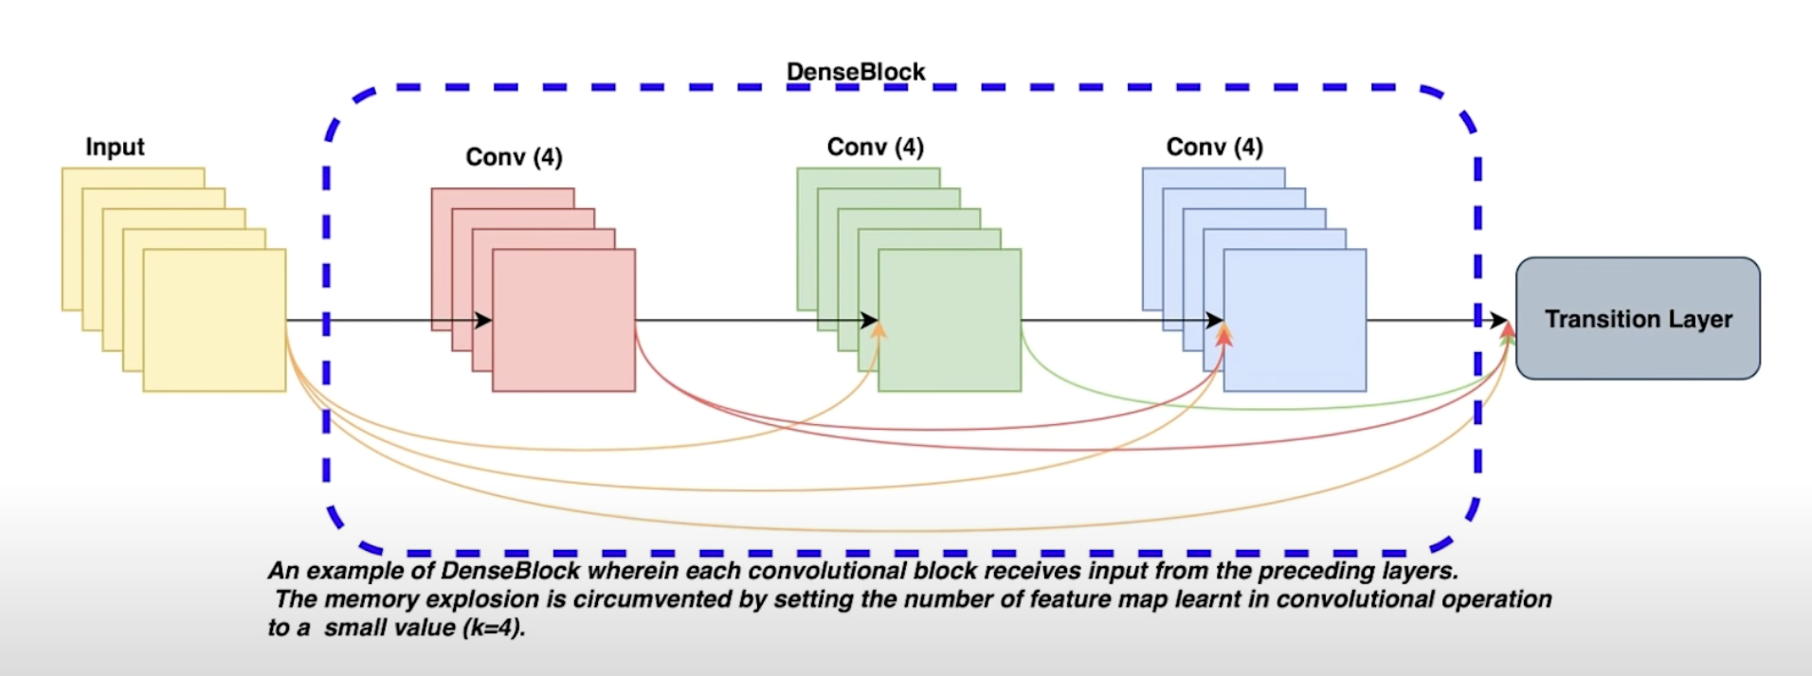
Introduction
Parameter Efficiency
L(L+1) / 2 connections
Implicit Deep Supervision
Max Pooling
DenseNet architecture[1]
[1] Huang, G., Liu, Z., Van Der Maaten, L., & Weinberger, K. Q. (2017). Densely connected convolutional networks. In Proceedings of the IEEE conference on computer vision and pattern recognition (pp. 4700-4708).
Notes:
[1] Reference here as well

Slide 3
Problem statement
Medical imaging aids chest disease diagnosis.
Chest diseases classification using DenseNet121
Deep learning automated image analysis
[1] Huang, G., Liu, Z., Van Der Maaten, L., & Weinberger, K. Q. (2017). Densely connected convolutional networks. In Proceedings of the IEEE conference on computer vision and pattern recognition (pp. 4700-4708).
Notes:
[1] Reference here as well

Slide 4
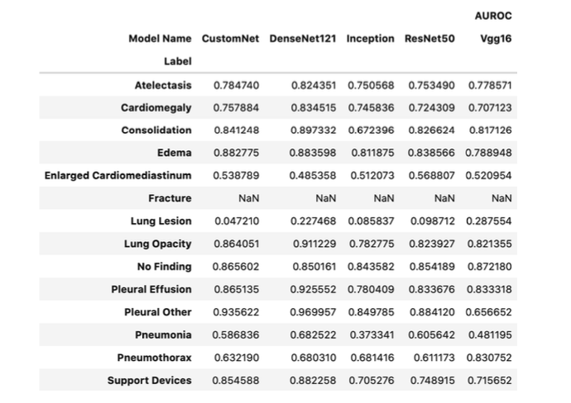
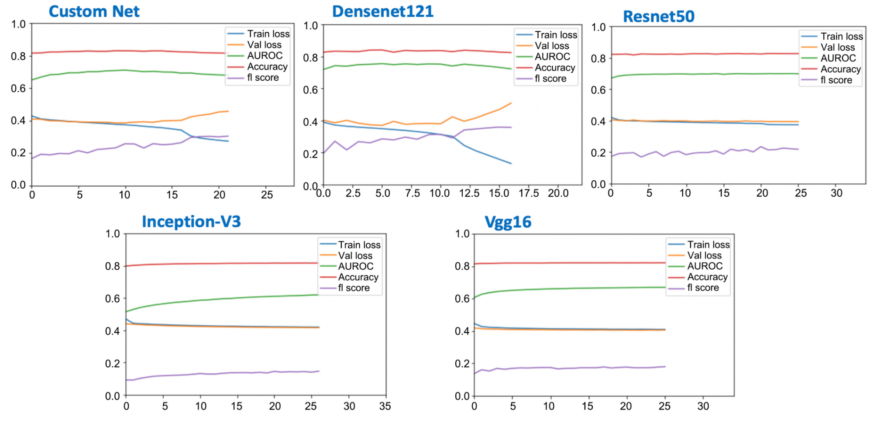
Existing body of work
Deep learning models achieve high accuracy.
Imbalanced training data affects positive case prediction.
Careful management of training data enhances performance.
Comparison of AUCROC of different models on test labels [2]
Training metrics per epoch.[3]
[2-3] Multi-label chest X-ray classification via deep learning. (2022, October 31). https://doi.org/10.4236/jilsa.2022.144004

Slide 5
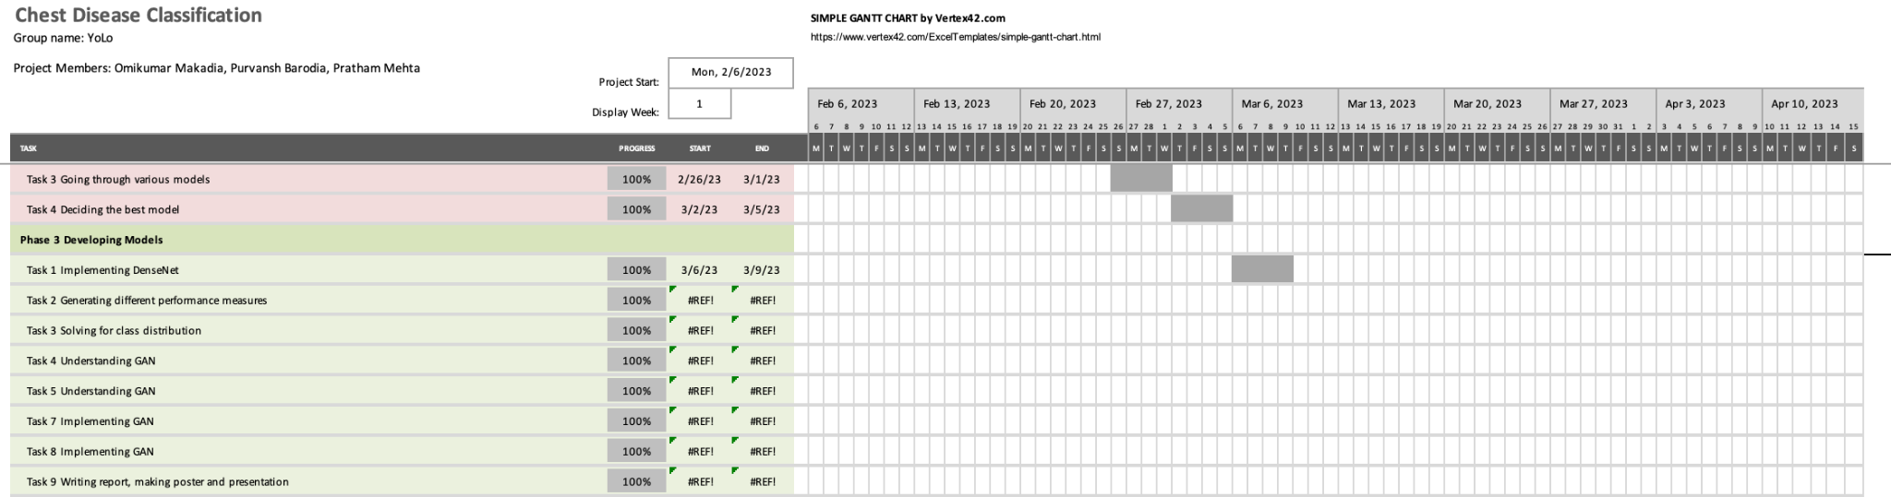
GANTT chart showing the project progress

Slide 6
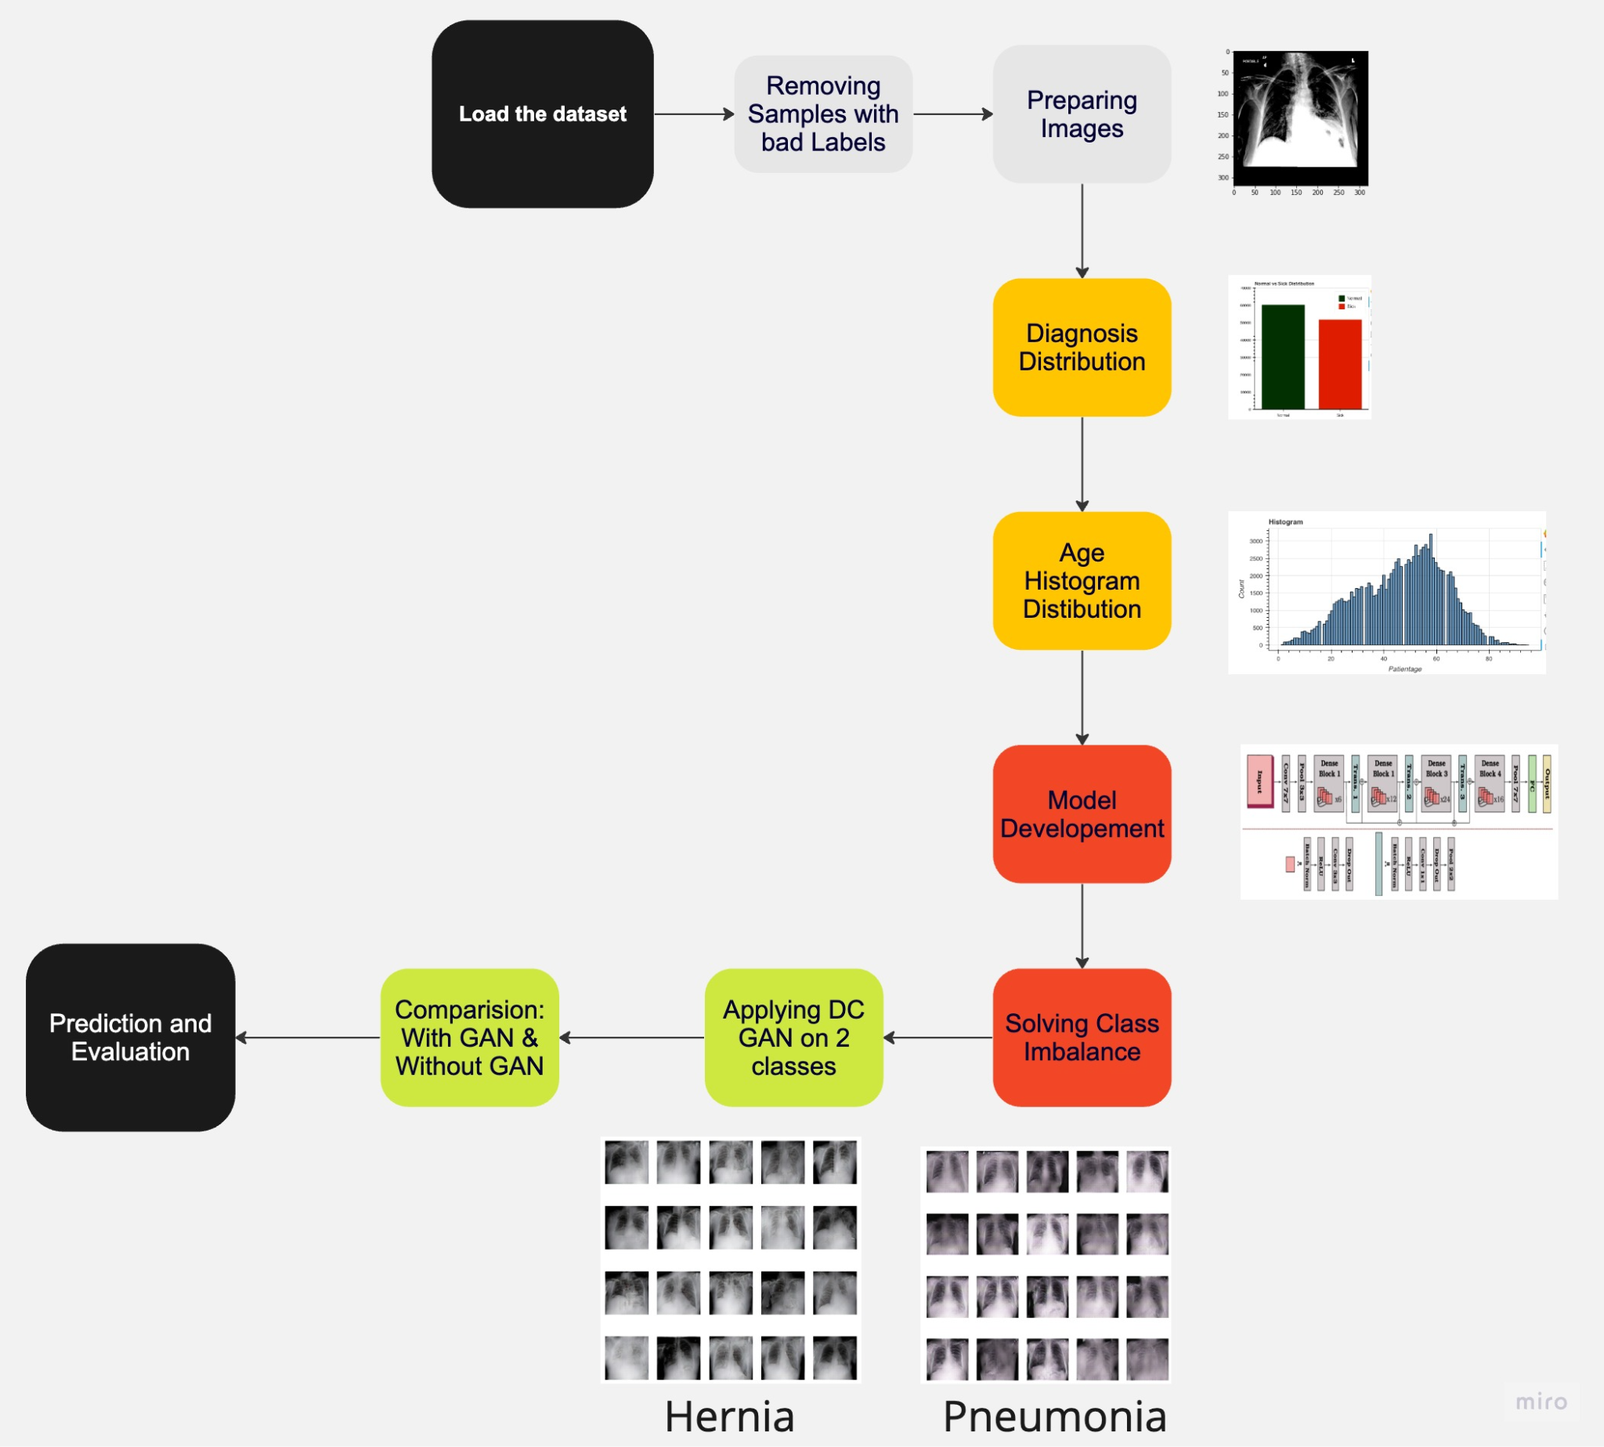
Your Approach
[3] Approach_ML. (n.d.). miro.com. https://miro.com/app/board/uXjVMe16ijI=/?share_link_id=565798120623

Slide 7
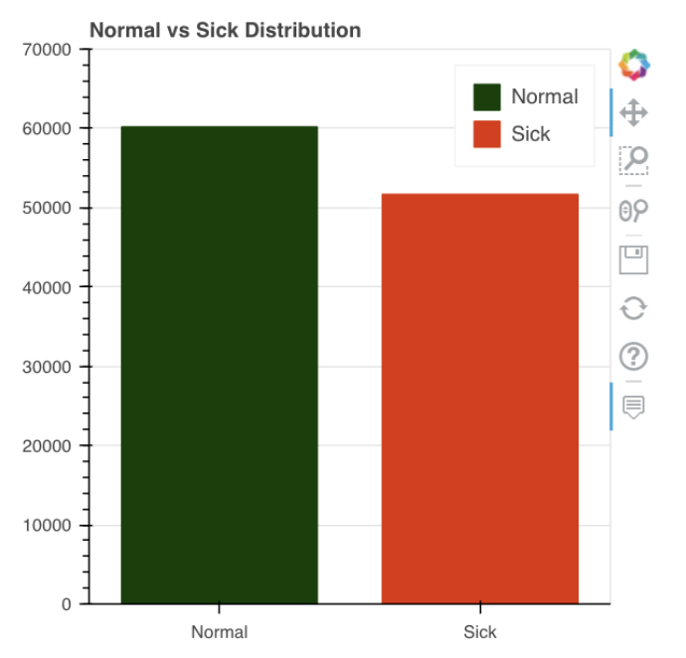
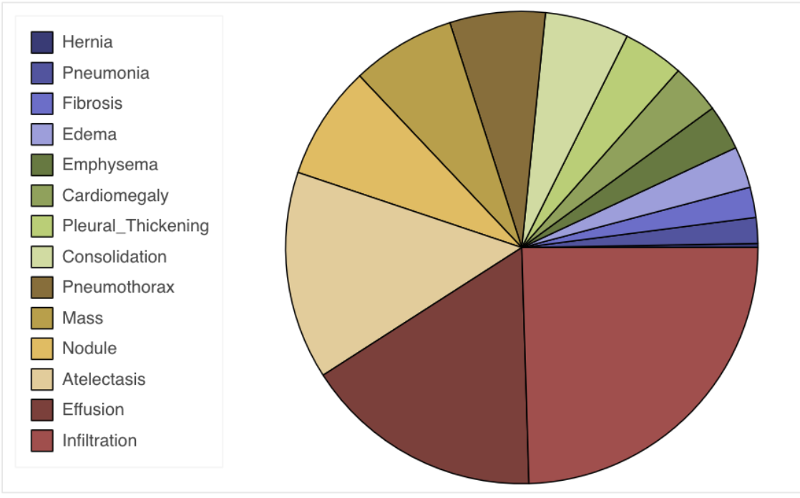
Results(1/5)
Diagnosis Distribution [5]
Diagnosis distribution - normal vs sick [4]
[4-5] Omikumarmakadia2121. (2023, March 10). Chest X-ray classifier DenseNet + Begineer's code. Kaggle: Your Machine Learning and Data Science Community. https://www.kaggle.com/code/omikuxmarmakadia2121/chest-x-ray-classifier-densenet-begineer-s-code/notebook

Slide 8
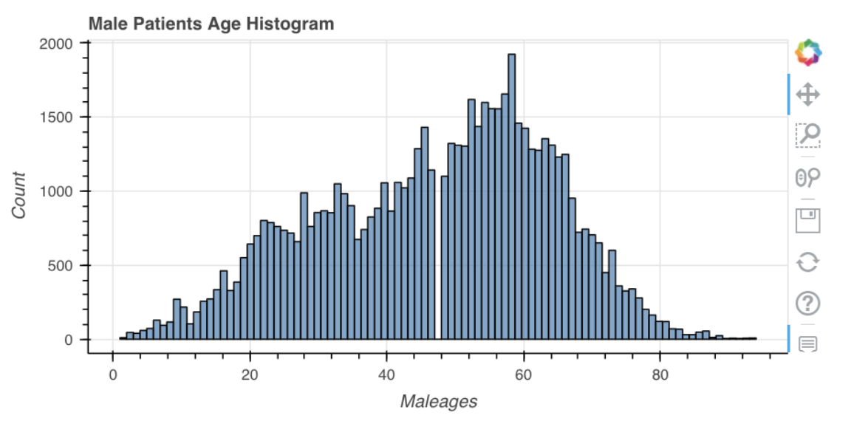
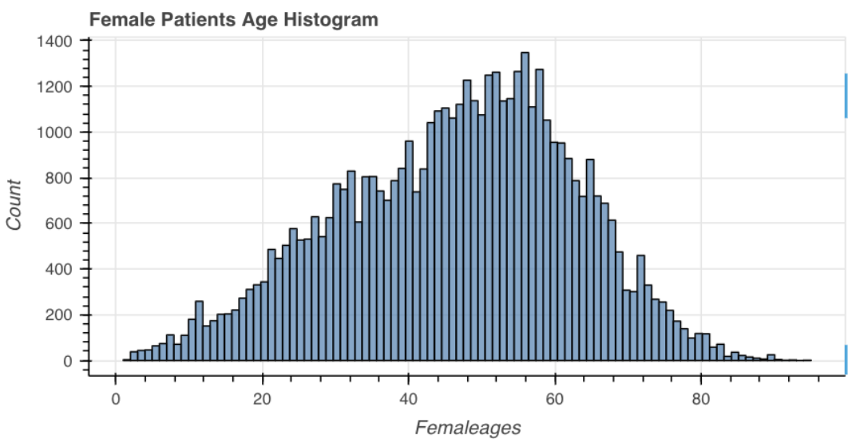
Results(2/5)
Age Histogram Distribution - Male[6]
Age Histogram Distribution - Female[7]
[6-7] Omikumarmakadia2121. (2023, March 10). Chest X-ray classifier DenseNet + Begineer's code. Kaggle: Your Machine Learning and Data Science Community. https://www.kaggle.com/code/omikuxmarmakadia2121/chest-x-ray-classifier-densenet-begineer-s-code/notebook

Slide 9
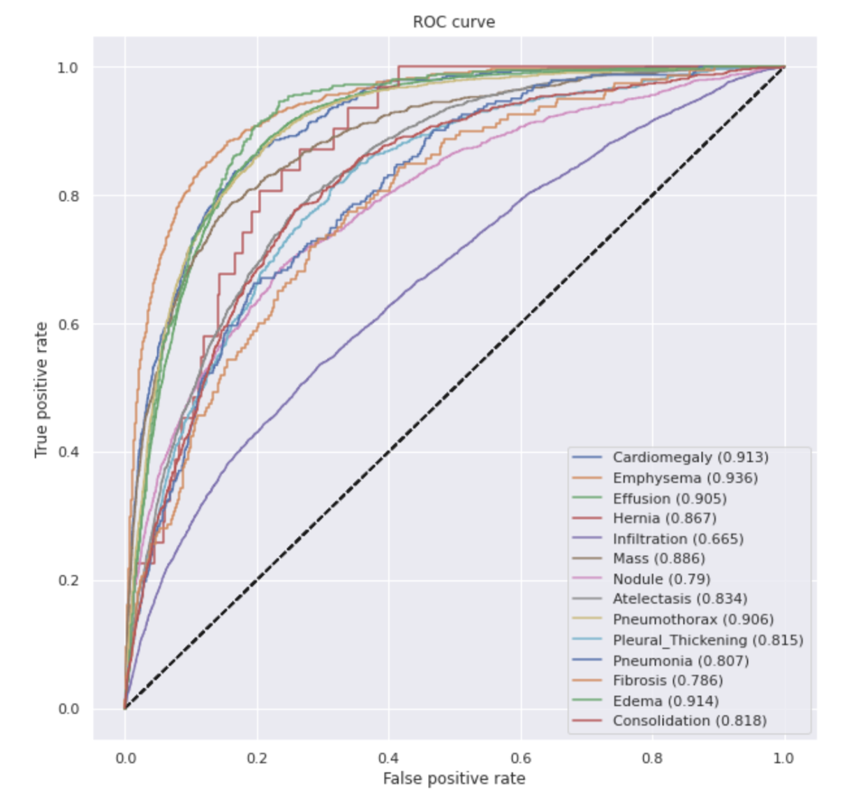
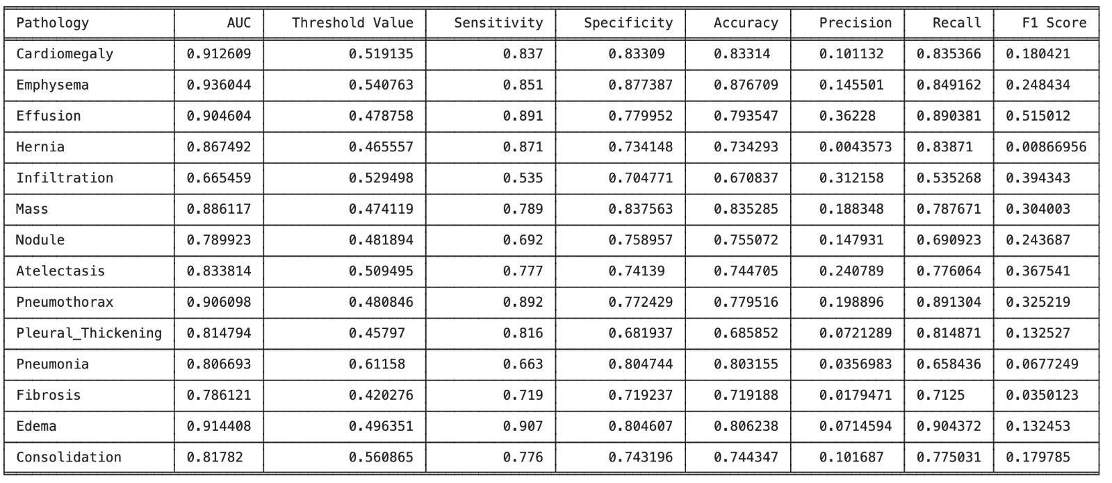
Results(3/5)
Various performance measures for each class present in the ChestXray 8 dataset [9]
The ROC curve [8]
[8-9] Omikumarmakadia2121. (2023, March 10). Chest X-ray classifier DenseNet + Begineer's code. Kaggle: Your Machine Learning and Data Science Community. https://www.kaggle.com/code/omikuxmarmakadia2121/chest-x-ray-classifier-densenet-s-code/notebook

Slide 10
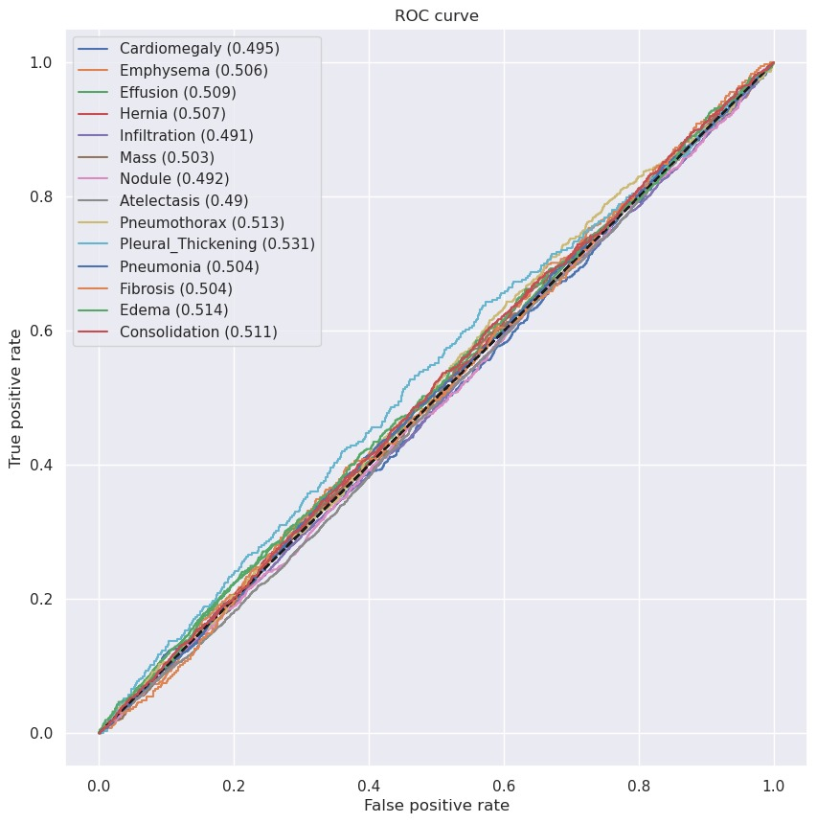
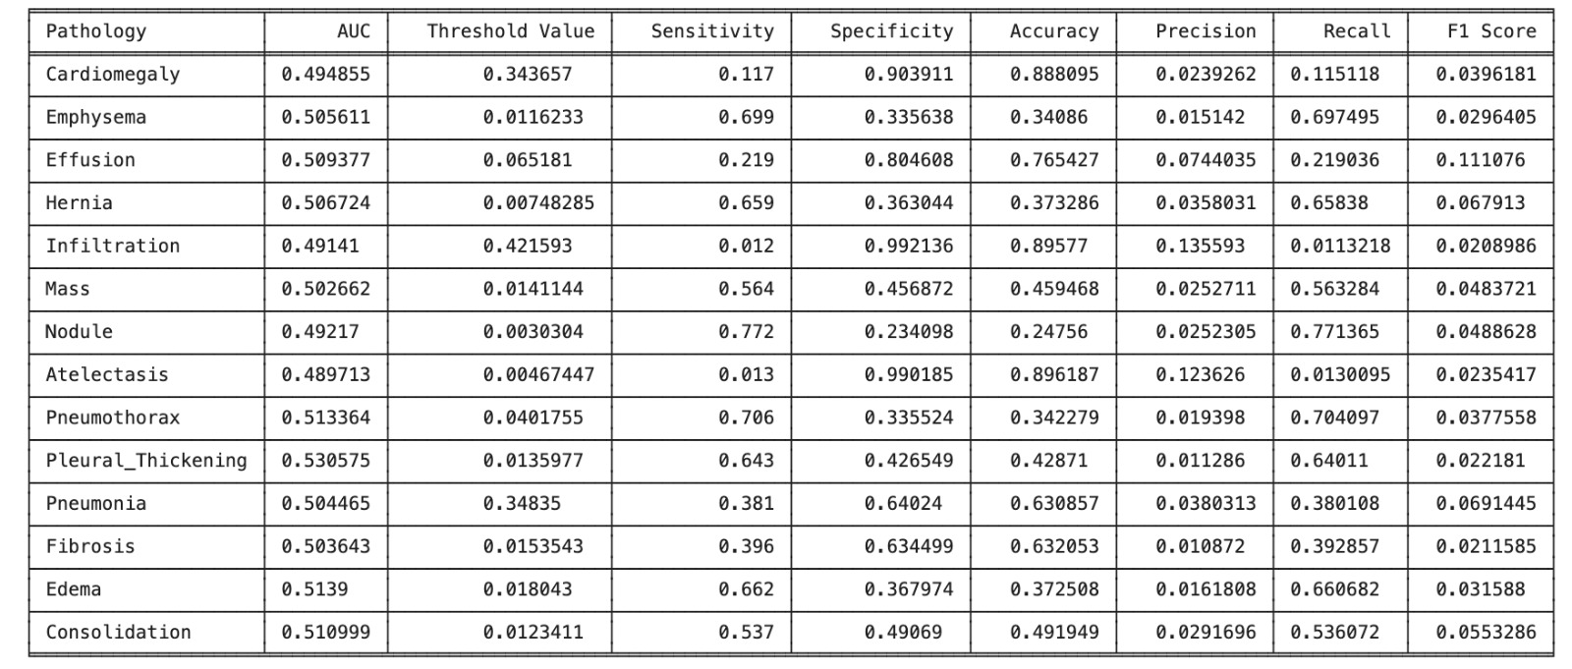
Results(4/5)

Slide 11
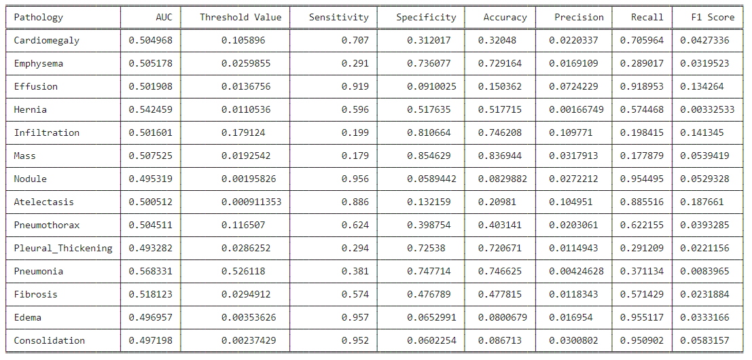
Results(5/5)

Slide 12
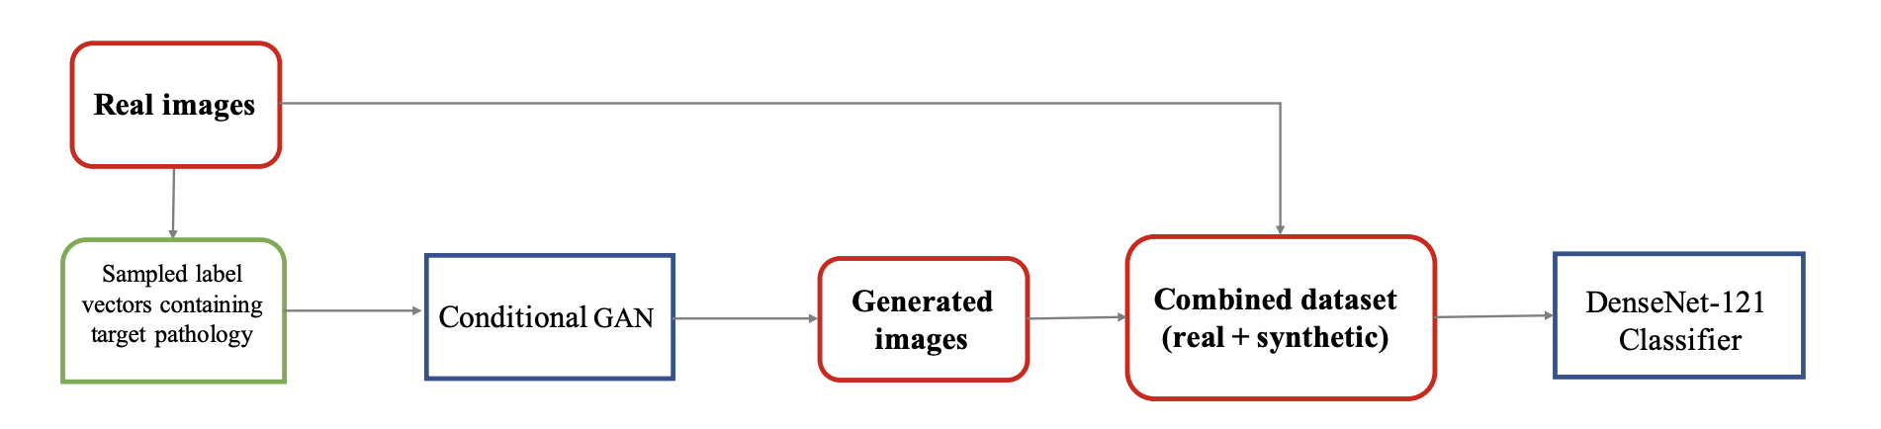
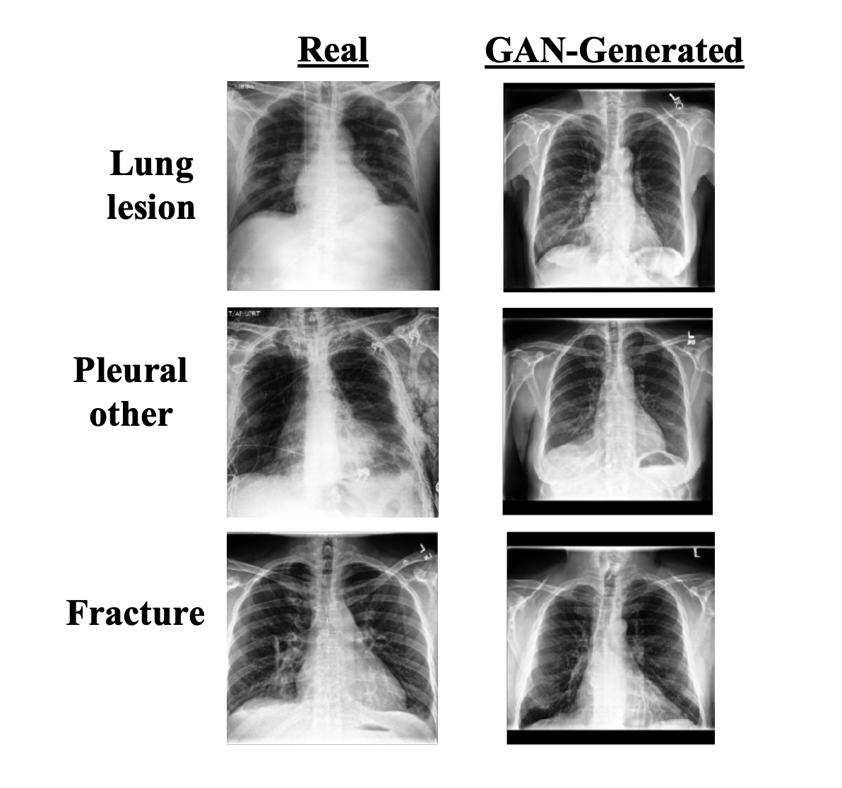
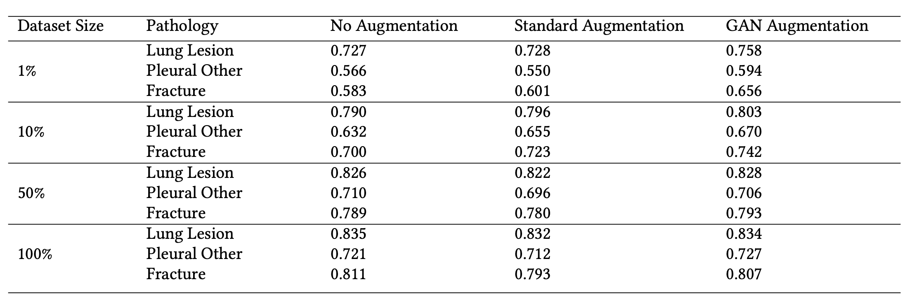
Role of each group member
Omikumar - Doing literature Survey, LaTex report, PPT making, Dataset implementation
Pratham - Model implementation, weekly report, report content , PPT making
Purvansh - Model understanding, weekly report, PPT making, report content
Class Imbalance Problem
Synthetic Data Augmentation
Approach of the proposed architecture[11]
GAN based Image generation [10]
AUC performance[12]
[10-11-12] Sundaram, S., & Hulkund, N. (2021). Gan-based data augmentation for chest x-ray classification. arXiv preprint arXiv:2107.02970.

Slide 13
References
[1] Huang, G., Liu, Z., Van Der Maaten, L., & Weinberger, K. Q. (2017). Densely connected convolutional networks. In Proceedings of the IEEE conference on computer vision and pattern recognition (pp. 4700-4708).
[2-3] Multi-label chest X-ray classification via deep learning. (2022, October 31). https://doi.org/10.4236/jilsa.2022.144004
[4-5] Omikumarmakadia2121. (2023, March 10). Chest X-ray classifier DenseNet + Begineer's code. Kaggle: Your Machine Learning and Data Science Community. https://www.kaggle.com/code/omikuxmarmakadia2121/chest-x-ray-classifier-densenet-begineer-s-code/notebook
[6-7-8-9] Omikumarmakadia2121. (2023, March 10). Chest X-ray classifier DenseNet + Begineer's code. Kaggle: Your Machine Learning and Data Science Community. https://www.kaggle.com/code/omikuxmarmakadia2121/chest-x-ray-classifier-densenet-begineer-s-code/notebook
[10-11-12] Sundaram, S., & Hulkund, N. (2021). Gan-based data augmentation for chest x-ray classification. arXiv preprint arXiv:2107.02970.

Slide 14
Thank you !
pratham.m@ahduni.edu.in
omikumar.m@ahduni.edu.in
purvansh.b@ahduni.edu.in

